Slide 1
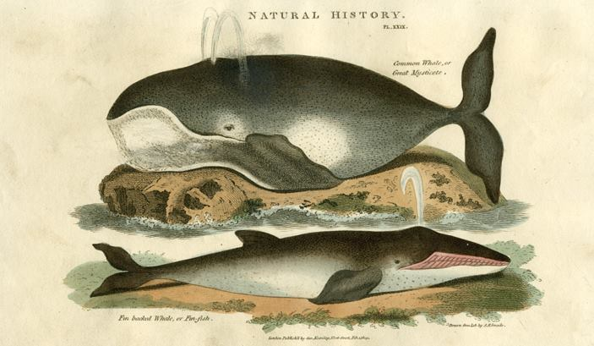
Bound for South Australia 1836 A Whale Of A Time Week 10
"Common Whale, Fin backed Whale or Fin-fish” published in A New Cabinet Cyclopedia .., 1819

Slide 2
Overview
Between February and July 1836 nine ships left Britain bound for the newly created province of South Australia. On-board the ships were passengers who over many long months braved the perils of the ocean, including some of the most treacherous seas in the world to begin a new life on the other side of the world.
This resource uses the stories from these nine ships as recorded by the passengers and crew in their personal journals.

Slide 3
Contents
Introduction
Journal entries
Inquiry Questions
Relevant images
Glossary of terms

Slide 4
Introduction
We hear from Captain Martin on the John Pirie again this week as he sights a whale in the grey of the evening. The whale is about three miles away and is spouting water to a great height in the air. This week we will think about how humans have shared the ocean and interacted with whales over time.

Slide 5
Journal entries Monday 25 April 1836
Captain Robert Morgan, on board the Duke of York wrote.
All this 24 hours light winds from the NE^{d} all sail set steering SW½S and SW by S employed drawing and knoting yarns making senet boat sails and grinding harpoons the cooper making line tubs PM Obsd a distance between À and Å which gives our Long^{d} 23.59 West Latt^{d} 25.52 North

Slide 6
Wednesday 27 April 1836
John Pirie journal writer, on board the John Pirie wrote.
The Weather has remain’d uncommonly fine since Sunday, accomp^{d} with a smart Breeze from N,E, and at Day light this Morng we could just discern the tops of the high Lands, in the Island of Porto-Santo, shortly after which, saw the Island of Madeira, and before it was dark, passed through between them, keep- ing Porto-Santo, with a few Islands called the Desertas, on our larboard , and Madeira on the star- board Side _______ In the grey of the Even^{g} we got sight of a Whale, about 3 Miles from us, it was spou- -ting up Water to a great height in the Air _______

Slide 7
Inquiry Questions
On April 27th Captain Martin writes about a whale sighting. How do you think the passengers and crew felt when they saw the whale?
What species of whale do you think it could be?
How likely do you think would it be to see the same species of whale in this area today?
What information can we learn from Captain Martin’s recount of sighting the whale?

Slide 8
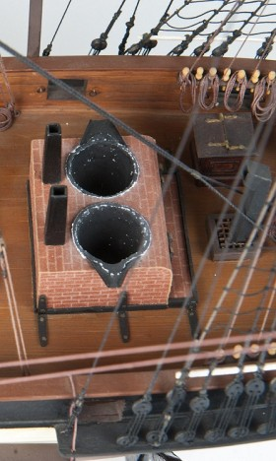
Images
Duke of York model showing try pots bricked in to the ship's deck

Slide 9
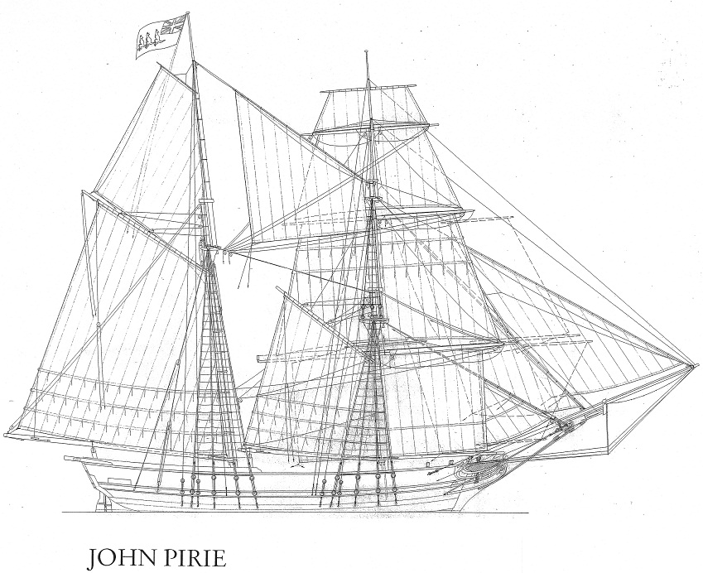
Reconstructed plans of the John Pirie, courtesy of Bob Sexton 2011

Slide 10
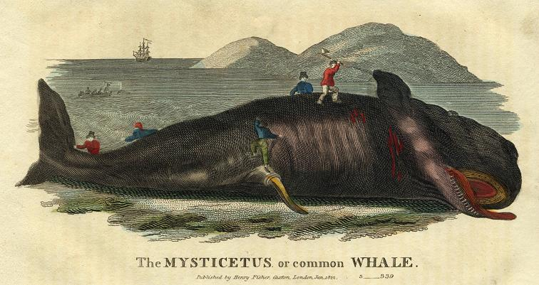
"Whale" engraved by T.Dixon, published in Oliver Goldsmith's History of the Earth and Animated Nature', 1822.

Slide 11
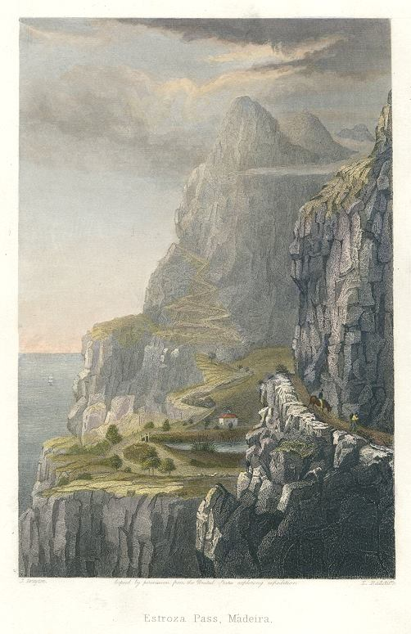
"Estroza Pass, Madeira" engraved by E.Radclyffe after a picture by J.Drayton, published in Gallery of Nature, 1846

Slide 12
Glossary of terms
Drawing and knoting yarns
Extracting threads from old rope and knotting them together for further use.
larboard
The old term for the left hand side of a ship looking forward. The right hand side is starboard. To avoid mis-hearing an order, it is now referred to as ‘port’.
Lattitude
Latitude is the distance of a point north or south of the equator as measured in degrees. The poles are at 90 degrees north and south.
Line tubs
Coopered wooden tubs in which the whale line attached to a harpoon was coiled ready for use in the whaleboats.
Longitude
Longitude is the distance, measured in degrees, of the meridian on which a point lies to the meridian of Greenwich. On the other side of the earth to Greenwich is a point with a longitude of both 180 degrees east and 180 degrees west.
Return to Journal Entries

Slide 13
Obsd a distance
Observed the angle between the sun and moon, which was known as a ‘lunar distance’. Taken at a time related to the midday as determined by the sun’s passing, the longitude could then be calculated and use of this method was indicated by the symbol ‘À and Å’.
Senet
Sennit (correct spelling) is a flattened form of rope made by plaiting three or more rope-yarns together.
star-board
The starboard is the right side of a ship or a boat perceived by a person on board facing the bow (front).The left side was originally called ‘larboard’ but in the early nineteenth century that term was replaced by ‘port’ to avoid the crew mis-hearing an order. The change was made official in 1844
Return to Journal Entries

