Slide 1
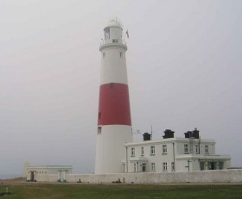
Bound for South Australia 1836 Signs and Symbols Week 19
Portland Bill Lighthouse

Slide 2
Overview
Between February and July 1836 nine ships left Britain bound for the newly created province of South Australia. On-board the ships were passengers who over many long months braved the perils of the ocean, including some of the most treacherous seas in the world to begin a new life on the other side of the world.
This resource uses the stories from these nine ships as recorded by the passengers and crew in their personal journals.

Slide 3
Contents
Introduction
Journal entries
Inquiry Questions
Glossary of terms

Slide 4
Introduction
This week a number of the journal entries make reference to sending and receiving written communication in the form of letters. In week 3 we learnt about the postal system in England in 1836, but what were some of the other forms of communication used during this time? How were signs and symbols used to communicate, both on shore and at sea during the 19th century, and are they still used today?

Slide 5
Journal entries Thursday 30 June 1836
Boyle Travers Finniss, on board the Cygnet wrote:
30th. The custom house flag was set on the fore mast .

Slide 6
Inquiry Questions
On the 30th June, the Cygnet diary entry states that 'the custom house flag was set on the fore mast.' What do you think was meant by this and why would such a flag have been raised?
Examine a boating vessel used today and locate the different signs and symbols used or displayed. How do these compare to those in 1836?
How are signs and symbols used to communicate messages at sea?
How has technology changed the use of signs and symbols at sea? Explore both written and non written forms of communication.

Slide 7
Glossary of Terms
custom house flag
A flag hoisted ashore to indicate that the vessel has been cleared out at Customs and is legally free to leave port. However, on the day a ship is to sail a ‘Blue Peter’ is hoisted at the head of the foremast. This flag is blue with a central white square.
Return to Journal Entries

