Slide 1
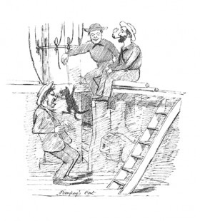
Bound for South Australia 1836 Pets Week 24
Pomfrey’s cat. Edward Snell, 1849

Slide 2
Overview
Between February and July 1836 nine ships left Britain bound for the newly created province of South Australia. On-board the ships were passengers who over many long months braved the perils of the ocean, including some of the most treacherous seas in the world to begin a new life on the other side of the world.
This resource uses the stories from these nine ships as recorded by the passengers and crew in their personal journals.

Slide 3
Contents
Introduction
Journal entries
Inquiry Questions
Relevant images
Glossary of terms

Slide 4
Introduction
This is both a week of joy and sadness onboard the Africaine. On the 1st August, we start with a birthday celebration, while the very next day we are saddened with the news that Kate, a cat belonging to Helen, the daughter of Mary Thomas was thrown overboard and never seen again. Is there a correlation between these events? Did a night of celebrations and too much drink lead to someone committing a terrible act? This week’s journals give us an insight into the highs and lows of life onboard.
It is interesting to note that Mary Thomas, upon her arrival in South Australia and after learning more about the fate of Kate the cat added comments to her journal. Her entries draw the reader in, containing great detail and effectively use descriptive language. This week we will focus on Mary Thomas, examining the content and language features of her journals.

Slide 5
Journals from passengers at sea: Monday 1 August 1836
Robert Gouger, on board the Africaine wrote:
Warmly did our hearts respond to those of our friends who on the 1st of this month would celebrate at Barkway the anniversary of Harriet’s birthday. How often did we talk over the events which were probably being enacted at the moment of our speaking! And herein we had an advantage over our Barkway friends for knowing the exact difference of time between our position on the globe and theirs, we were able to fix upon the precise moment for dinner, for the usual course of toasts and expressions of kindness & affection, and, last of all, for the striking of the hour of twelve, when we knew Caroline would in her own inimitable style give the crowning glass to the whole – at the same hour the time having been calculated to the minute, Harriet & I joined in ardently wishing every blessing to be the portion of each around her.

Slide 6
Tuesday 2 August 1836
Mary Thomas, on board the Africaine wrote:
Who killed my cat? Suppose I tell; Unless deceived, I know full well; But you, perhaps, may guess the plot When I have told you who ‘twas not. ‘Twas not the captain nor the mate, For they, I’m sure, had no such hate, But both expressed their deep regret That Puss with such a fate had met. ‘Twas not the steward; he desired That she should every day be fed, And said, ‘I tink dat man so bad Who dared do wicked act so sad.’ ‘Twas not the sailors; one and all They would apprehend a squall,

Slide 7
And vow that man should drowned be Who threw a cat into the sea. ‘Twas non who in the steerage dwelt, For they had more humanely felt, And all, with Nature’s truth inspired, Her stripes and beauty much admired. Who was it, then, who killed my cat?

Slide 8
Friday 5 August 1836
George Stevenson, on board the Buffalo wrote:
….
I had some difficulty before leaving St Helen’s in procuring a number of cats to be sent on shore. They were very numerous and had crept under the berths of the emigrants, which is the main cause of the horrid effluvia now existing. Cats are probably valuable in the colony, but whoever takes them out should be obliged to keep them sweet and clean and confined to a hutch during the voyage.

Slide 9
Inquiry Questions
What does George Stevenson onboard the Buffalo mean when he writes that people should be obliged to keep their “cats sweet and clean and confined to a hutch during the voyage?
What guidelines do you think should be in place onboard these vessels to ensure cats and pets are not a nuisance to others?
How has the introduction of cats in Australia affected ecosystems and native animals?

Slide 10
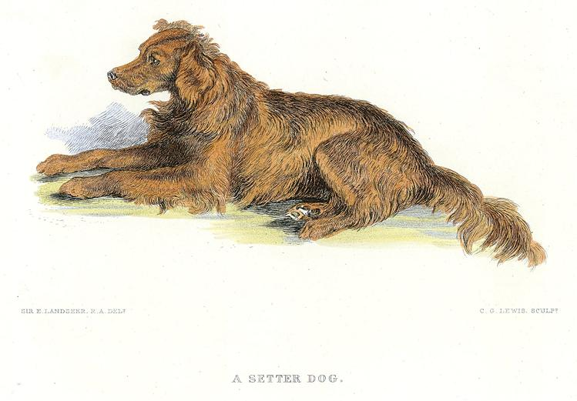
Images
“A Setter Dog” engraved by C.G.Lewis after a picture by Sir Edwin Landseer, published in the The Works of Sir Edwin Landseer RA, 1878. Steel engraved antique print with recent hand colouring. Ref E6899. Image courtsey of ancestryimages.com

Slide 11
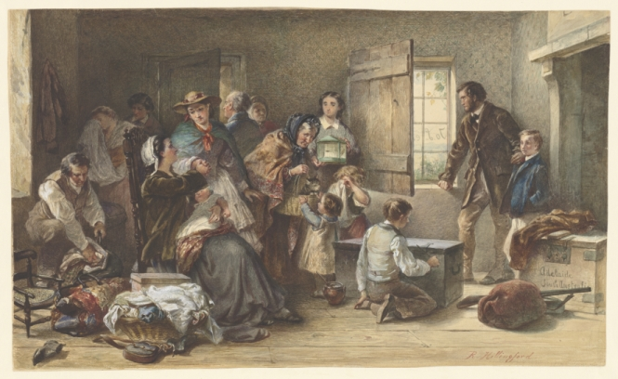
Emigrants to South Australia, circa 1860 by Robert Hillingford. Image courtesy of the National Library of Australia, PIC T2278.

Slide 12
Glossary of Terms
Squall
A squall is a sudden, sharp increase in wind speed.
Return to Journal Entries

