Slide 1
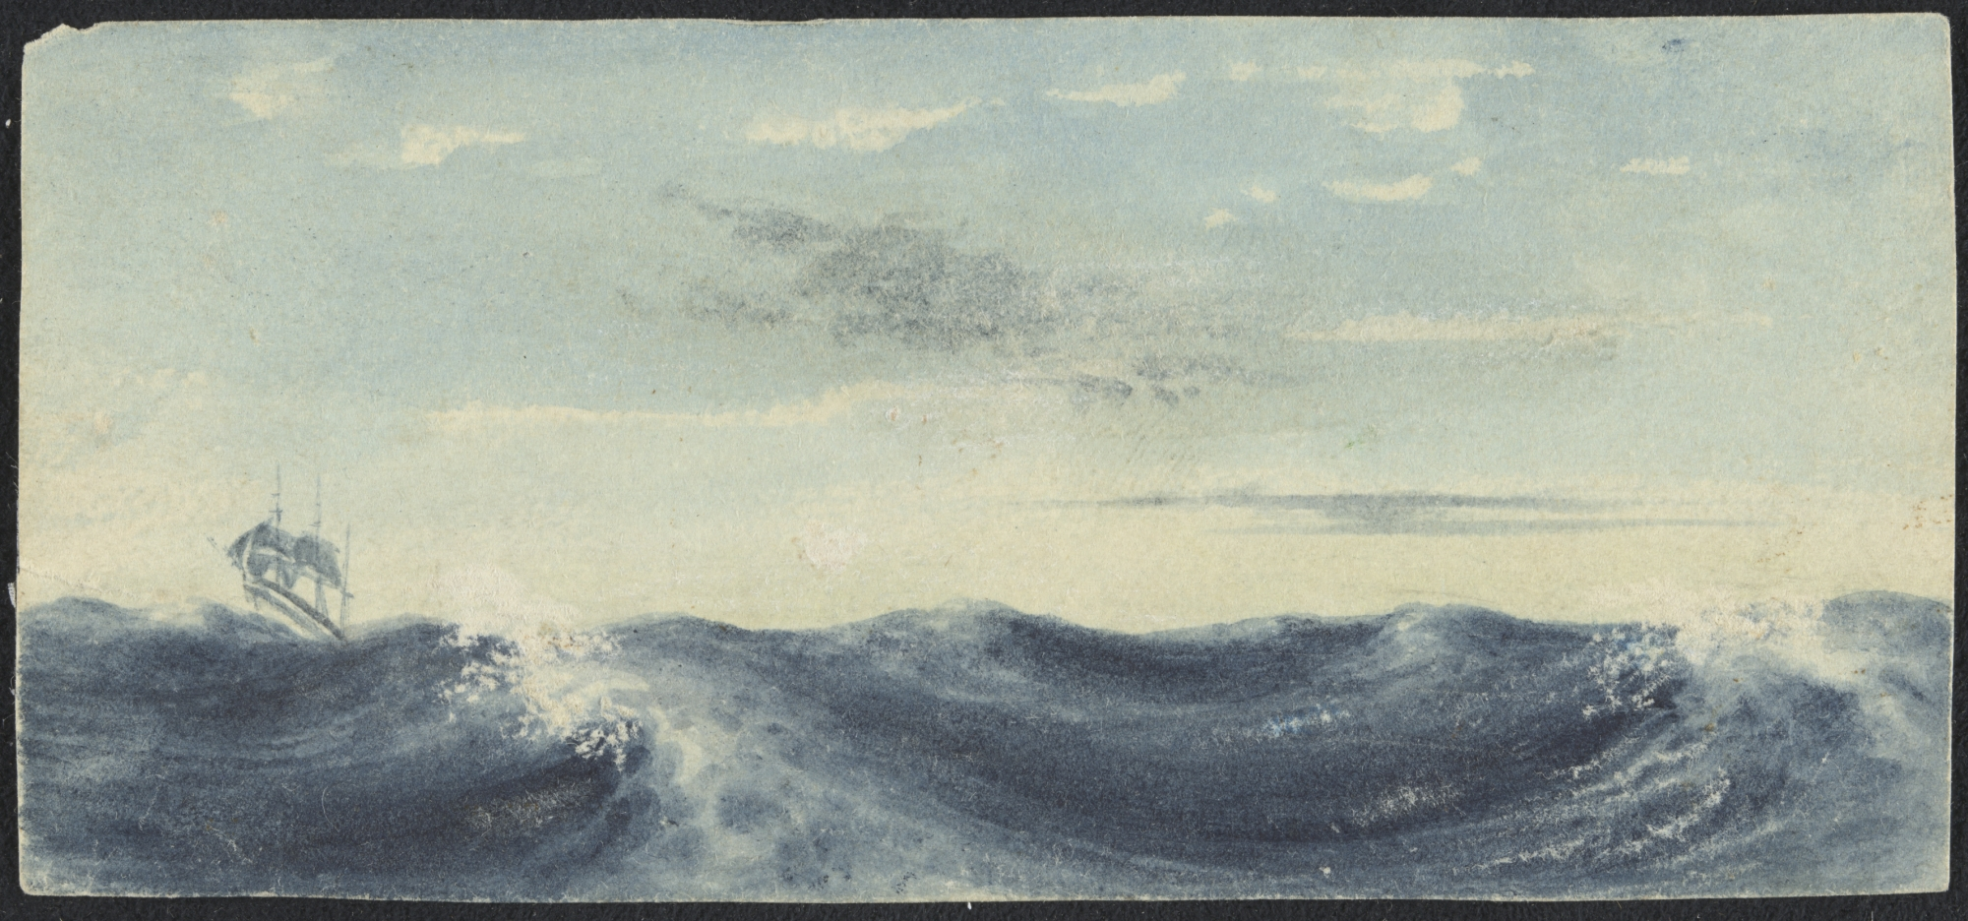
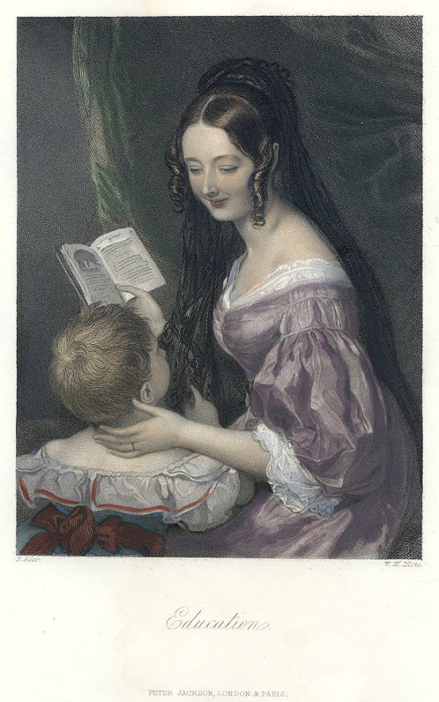
Bound for South Australia 1836
Education
Week 28
"Education" engraved by W.H.Mote after a picture by J.Ross, published in Fisher's Drawing Room Scrap Book, 1850.

Slide 2
Overview
Between February and July 1836 nine ships left Britain bound for the newly created province of South Australia. On-board the ships were passengers who over many long months braved the perils of the ocean, including some of the most treacherous seas in the world to begin a new life on the other side of the world.
This resource uses the stories from these nine ships as recorded by the passengers and crew in their personal journals.

Slide 3
Contents
Introduction
Journal entries
Inquiry Questions
Glossary of terms

Slide 4
Introduction
Last week we learnt about the skills needed to successfully navigate a ship, both in 1836 and today. This week more navigational references are made in Hutchinson’s journal. How would these skills have been acquired and what education would have been required in 1836 to navigate a ship successfully across the globe? There were a number of children onboard the Buffalo, travelling to South Australia. Had these children been going to school back in England? What sorts of skills would they have brought with them and what skills what they been taught during the journey? Stevenson in his journal makes a number of references to children, expressing his concern about their lack of education during the journey. How important was schooling in 1836 and what knowledge, skills and understandings did children need for life in the new colony?

Slide 5
Journals from passengers at sea:
Sunday 28 August 1836
George Stevenson, on board the Buffalo wrote:
  … For Service to-day
  had substituted the Articles of War. Surely in the lazy
  listlessness of existence at sea there might have been
  sufficient time for both – if indeed reading the Mutiny
  Act be at all a fitting employment for the day. No
  Sunday School. So we thought it would be. What the
  plea is we know not. But all this is exceedingly un-
  -satisfactory. There are no school books on board to give
  to the Emigrants’ children – an unhappy oversight, for
  they might have been advantageously instructed during
  these long and sleepy days. It will be important to see
  that in all future emigrant Ships a person in some
  degree qualified to act as Schoolmaster, be sent out.
  Next to the Surgeon he would be the most useful person
  in the vessel.

Slide 6
Inquiry Questions
What was the English education system like in 1836?
How have the skills and understandings required for adulthood changed between 1836 and today?
What types of schools existed in England in 1836 and who controlled them?
How did the education of boys and girls differ in 1836?

Slide 7
Glossary of Terms
Articles of war
The regulations which govern the behaviour of members of the Royal Navy.
Return to Journal Entries

