Slide 1
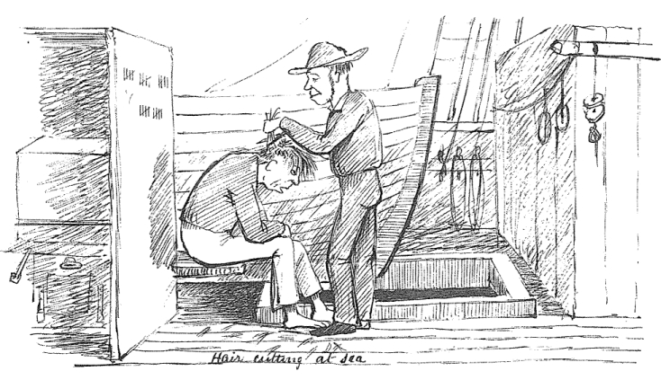
Bound for South Australia 1836 Discipline and Punishment Week 29
Hair cutting at sea. Edward Snell, 1849

Slide 2
Overview
Between February and July 1836 nine ships left Britain bound for the newly created province of South Australia. On-board the ships were passengers who over many long months braved the perils of the ocean, including some of the most treacherous seas in the world to begin a new life on the other side of the world.
This resource uses the stories from these nine ships as recorded by the passengers and crew in their personal journals.

Slide 3
Content
Introduction
Journal entries
Inquiry Questions
Glossary of terms

Slide 4
Imtroduction
We visit the Africaine this week to meet young Margaret Clark. Margaret is a
servant girl for the Gouger family and she often finds herself in trouble! This
week is no exception as Margaret has just bitten another servant girl on the
arm until she drew blood and left teeth marks in the girl’s skin. The captain
decides to punish Margaret by ordering one of the stewards to cut off the hair
from one side of Margaret’s head. Margaret, however, thinks that this is a
huge joke and laughs and talks to the steward while he cuts her hair. Gouger
plans to leave Margaret at the Cape of Good Hope under the protection of
the Children’s Friend Society in exchange for another girl. Do you think these
consequences are appropriate for Margaret’s behaviour? This week we will
investigate discipline onboard our ships and find out what happens when
passengers do not follow the rules.

Slide 5
Journals from settlers in South Australia: Sunday 4 September 1836
Samuel Stephens, who arrived in South Australia on board the Duke of York wrote:
4th (Sunday) This day had been spent by us quietly & orderly
but it has been a Melancholy day to me. I cannot & will not
endure this state of things it shall be mended by some means
or other. I had no divine service to day. Capn Martin spent the
afternoon with me ashore & we agreed as a last effort to
establish order (by fair means) he should invite Mr Beare & Mr
Birdseye to lunch on board the following morning & that I should
follow in my boat & try whether face to face with them in his Cabin we
could not all come to some better understanding.

Slide 6
Monday 5 September 1836
Samuel Stephens, who arrived in South Australia on board the Duke of York wrote
5th Rose & set the hands to work &c as usual – at ½ past 9 M^{r} Birdseye
made his first appearance & was asked by Cap^{n} Martin (who was ashore
with me by 10 M. P. 6 A.M.) to go on board. About ½ past 10 the Cap^{n}, M^{r}
Beare & M^{r} Birdseye Put off & I followed soon after. Cap^{n} Martin by his
exceedingly judicious behaviour to day has indeed rendered valuable
service to the Company. Both the officers agreed to return to their duty
heartily. I shook hands with them in the Cabin. We all returned to the
Shore together & they took tea & supper with me. On our return I had all
the men called together & with my officers (for the first time) by my side
gave them a short address in reference both to the past & to the future,
gave them my rules & intentions as to their future Discipline, time of

Slide 7
labour, general behaviour &c & they all retired pleasantly. James &
Joseph Jones came in to ask for employment again. I allowed Joseph to
return to his duty under his former agreement but James being a
worthless fellow & this being a fair opportunity of setting a wholesome
example, I would not receive him. I told him that if Mr Beare wanted an
extra hand for a few days at any time he was at liberty to engage him at
reduced wages & I would recover his advance as I might be able.

Slide 8
Tuesday 6 September 1836
Samuel Stephens, who arrived in South Australia on board the Duke of
York wrote:
6th The hands went to work this morning in good style under their
respective officers. I lay in bed till after 6 & on rising most sincerely
rendered thanks to Almighty God for the now really happy, orderly &
industrious appearance of our settlement. A more marked change I
never witnessed…
… James Jones came to day to solicit employment, and I allowed M^{r}
Beare to engage him at 2/- per day his wages under the agreement he
has violated were 15/- pr week with [illegible word] &c certain
employment &c – so that besides making an example the Company are
gainers by his rebellion

Slide 9
Thursday 8 September 1836
Samuel Stephens, who arrived in South Australia on board the Duke of York
wrote:
8th. A beautiful day & a happy one to me. We are all going
along in excellent temper & good discipline my last rebel (M^{r}
Schreyvogel) this morning came & asked my pardon &
requested I would allow him to resume his duties. I did so
immediately, & fancy that I shall not in a hurry have any of
them attempt to play the same pranks. I have been severely
tried for the last 6 weeks but thank God that I have been
sustained & that I have good reason to suppose peace & good
order is now permanently established…

Slide 10
Saturday 10 September 1836
Samuel Stephens, who arrived in South Australia on board the Duke of York
wrote:
…Having found that there had been a good deal
of petty thieving from the Company’s stores I to
day dismissed the person (Neal) who had the
charge (by night) of it and appointed M^{r}
Shreyvogel to take his place.

Slide 11
Journals from passengers at sea: Tuesday 6 September 1836
John White, on board the Tam O'Shanter wrote:
Tuesday Sept 6th 1836
W,S,W, Running 7 Knots
the trial of William Walters
Came on at 10 OClock he
was acquitted for the Want of
further Everdance

Slide 12
Thursday 8 September 1836
Robert Gouger, on board the Africaine wrote:
September 8th Margaret Clark is again in disgrace. Yesterday she bit her
fellow servant’s arm so as to cause the blood to flow from each
indentation of the teeth, and scratched her mercilessly. On the girl’s
complaining to me I sent her to the captain and requested him to use his
discretion about the punishment to be inflicted. Having heard both
parties and finding Clark altogether to blame, he ordered the steward to
cut off the hair from one side of her head which was immediately done;
the culprit however seemed to treat the matter rather as a good joke,
than as a punishment, laughing and talking with the people about her
during the whole operation. I cannot but think the girl is deranged; if not,
surely there never was so malicious and designing a little jade in human
guise. It is our intention to leave her at the Cape under the protection of
the Committee of the Children’s Friend Society , In exchange for another
girl if one can be procured. The other girl (Vincent) behaves with great
propriety and is fast ingratiating herself into the esteem of her mistress.

Slide 13
Inquiry Questions
How were passengers expected to behave onboard? Were the rules the same for everyone?
How were rules and behaviour expectations communicated to passengers?
What were the consequences for breaking rules or behaving in an unacceptable manner?
What was the role of servant girls onboard? How did their work at sea compare to a servant's life on land?
Who was responsible for the discipline of passengers and how were decisions made about punishment and consequences?

Slide 14
Glossary of Terms
Children’s Friend Society
The Children’s Friend Society was one of a number of schemes designed to promote child migration as a means of improving public order. It was formed in 1830 as the ‘Society for the Suppression of Juvenile Vagrancy, through the reformation and emigration of children’ and by 1832 had sent children to the Cape of Good Hope and the Swan River Colony. Others were sent to Canada.
jade
a derogatory term applied to women
Melancholy
A gloomy state of mind

