Slide 1
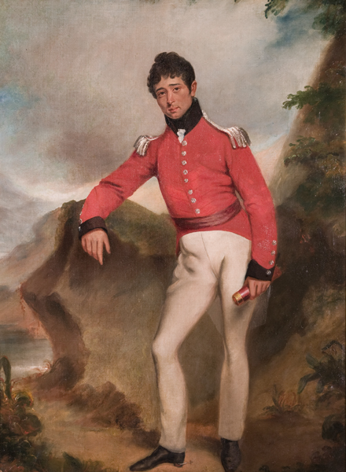
Bound for South Australia 1836 Fresh Water Week 33
Self Portrait, Colonel William Light. c.1815. Image courtesy Art Gallery of South Australia

Slide 2
Overview
Between February and July 1836 nine ships left Britain bound for the newly created province of South Australia. On-board the ships were passengers who over many long months braved the perils of the ocean, including some of the most treacherous seas in the world to begin a new life on the other side of the world.
This resource uses the stories from these nine ships as recorded by the passengers and crew in their personal journals.

Slide 3
Contents
Introduction
Journal entries
Inquiry Questions
Relevant images
Glossary of terms

Slide 4
Introduction
This week Colonel Light and his surveying party search for a suitable place to
establish the colony in South Australia. They hunt for sources of fresh water
and think about the best places for people to live, graze animals and grow
crops. We will join Colonel Light on his expedition and think about the
significance adequate supplies of fresh water has to the way people live and
form communities.

Slide 5
Journals from settlers in South Australia: Monday 3 October 1836
William Light, who arrived in South Australia on board the Rapid wrote:
3 October… at nine went on shore to examine the plains. And as two of my officers had said that they saw from the main-top something like a large river, only two miles from us to the southward, I resolved to walk there, and desired Mr Field to get under way and anchor the brig at the mouth – as should this prove to be the long-sought-for harbour of Jones, I could run the brig in and carry on the survey there. And at this place from the same point, our party consisted of Messrs Pullen, Claughton, Woodforde, a gardener named Laws, with a spade, and the gig’s crew; the latter were desired to pull along shore, and stop at the mouth of the river. Messrs Claughton, Woodforde and Laws kept some way inland to examine the soil as they went along, while Pullen and myself kept along the beach. Thus prepared not to miss the river, we proceeded, but about two miles off, we found nothing but a rather wide indenture of the coast, and were also surprised at the brig’s not anchoring, we therefore walked on about five

Slide 6
miles further, and finding nothing like a river, returned to where we landed. Mr Field seeing distinctly our movements on shore, came back to the former anchorage – and at four p.m. we all returned on board. I was much gratified at the report Laws gave me of the soil, he being a good judge. It was, he said, excellent, and the further inland he was certain it would be still more so.

Slide 7
Tuesday 4 October 1836
Dr John Woodforde, who arrived in South Australia on board the Rapid wrote:
9 p.m. Tuesday, 4th October. Remained on board all day. Colonel Light has been four miles up the river with which he is much pleased – the water is very good and it abounds with teal and other wild fowl. On the plain to the right of it he discovered several fresh water lagoons some of which are nearly a mile in length. The mouth of the stream is Lat. 34.59.

Slide 8
Wednesday 5 October 1836
William Light, who arrived in South Australia on board the Rapid wrote:
5 October-Light breezes and fine. Having much to do in observing several bearings from the ship, for the purpose of constructing my hasty chart of this side of the gulf, I remained at anchor, and sent Messrs Claughton and Jacob to trace the river up if they could, until they found fresh water in it. At one a.m. these gentlemen returned, and said the river about four miles from the mouth was fresh, it was then a very narrow stream bending to the N.E., and appeared to have its source in the plains-a circumstance that led me to suppose that more of these lagoons existed in that direction; and as every appearance indicated that these lagoons would be dry in summer, I felt convinced that the torrents from the mountains must be the fountain from whence they were now filled. My previous observations at sea,which I remarked often to Mr Field before I saw this country, were that all the vapours from the prevalent south-westerly winds would rest on the mountains here, and that we should, if we could locate this side the

Slide 9
gulf, be never in dread of those droughts so often experienced on the eastern coast of Australia. And I was now fully persuaded by the evidence here shown, as well as the repeated collection of clouds, and rain falling on the hills even at this season of the year.

Slide 10
Thursday 6 October 1836
William Light, who arrived in South Australia on board the Rapid wrote:
6 October…At six, got under way to run down the coast, as the native woman on board said there was still a large river more to the southward, which we had passed in coming up…

Slide 11
Thursday 6 October 1836
William Pullen, who arrived in South Australia on board the Rapid wrote:
Thursday 6th Weighed & stood down the Gulf about [blank] miles below the last anchorage from the Mast head was observed a stream apparently issuing from the hills and discharging a little below us into the sea. I was immediately despatched & found it to be small at the mouth but inc- -reasing in size inland & apparently deep water which I could not ascertain there being a heavy surf on could not get the boat in it is now called the Onkaparinga With every appearance of a Gale apparently not good anchorage so as soon as I reached the Brig the Colonel bore up for the last anchorage & there rode out a heavy gale not the first one which we had rode out here From the good holding ground it was named Holdfast Bay which it now retains.

Slide 12
Saturday 8 October 1836
Dr John Woodforde, who arrived in South Australia on board the Rapid wrote:
7 p.m. Saturday, 8th October. The wind having moderated a boat was sent off for the women – they had caught no game as they and the dogs were too hungry to hunt – a few roots were the only food they had had. After breakfast Claughton, Jacob, Pullen and myself landed with our guns and went up the banks of the river in search of wild fowl with which it was actually swarming but they were so wild and wary that we were very unsuccessful only having killed between us a duck and brace of teal. There are several lagoons, or what we should call marshes in England, in the neighbourhood of the river, in these wild fowl resort to breed and this is apparently breeding-season as we picked up a cygnet and young duck neither of them fledged. On our return we shot a brace of quails and a beautiful rail resembling our landrail in all but plumage which was much finer…

Slide 13
Inquiry Questions
What strategies does Colonel Light use when looking for evidence of fresh water sources?
Why does Colonel Light consider access to fresh water to be the most important factor in choosing where to establish the colony?
What other factors do Light and his crew consider when selecting a site for the settlement?
Light makes some predictions about rainfall and water supply in South Australia. How do these predictions compare to the current situation in South Australia?

Slide 14
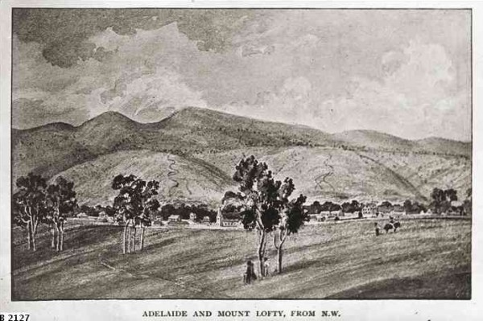
Images
Adelaide & Mt Lofty, c. 1837 (artist William Light) Image courtesy of the State Library of South Australia

Slide 15
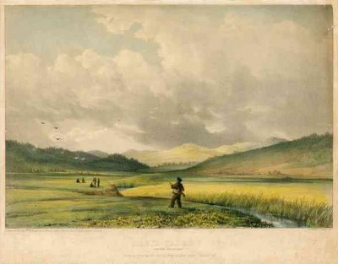
Second Valley, c. 1838. (artist William Light) SLSA B 7285

Slide 16
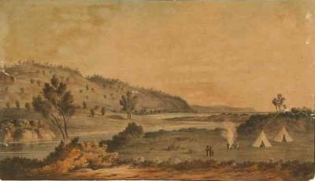
Courtesy of the State Library of South Australia
SLSA B8436 - view at Normanville, 1836

Slide 17
Glossary of Terms
Brig
A sailing vessel with two square-rigged masts.
Gig
A light, narrow ship’s boat that could be rowed or sailed.
Latitude
Latitude is the distance of a point north or south of the equator as measured in degrees. The poles are at 90 degrees north and south.

