Slide 1
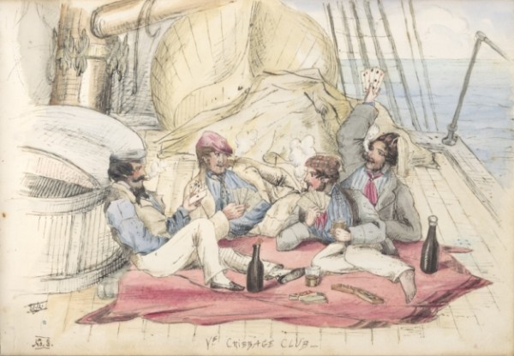
Bound for South Australia 1836 Pastimes Week 35
Ye Cribbage Club, E. C. Moore
Image Courtesy of the National Library of Australia

Slide 2
Overview
Between February and July 1836 nine ships left Britain bound for the newly created province of South Australia. On-board the ships were passengers who over many long months braved the perils of the ocean, including some of the most treacherous seas in the world to begin a new life on the other side of the world.
This resource uses the stories from these nine ships as recorded by the passengers and crew in their personal journals.

Slide 3
Contents
Introduction
Journal entries
Inquiry Questions
Relevant images
Glossary of terms

Slide 4
Introduction
As we read the different diary entries, we discover how different each journey to South Australia was. The personalities of passengers, resources, captains and weather conditions are some of the factors that influence the journey to South Australia. One thing that each journey seems to have in common is plenty of time for passengers to fill. In the most recent entries we read of a quarrel between Mary Thomas and the second mate onboard the Africaine. We also read Gouger’s comments about the excellent sailing conditions, while onboard the Buffalo passengers enjoy the fine conditions and partake in quadrilles and country dances on the deck. This week we will examine the ways passengers passed the time onboard.

Slide 5
Journals from passengers at sea: Sunday 16 October 1836
Young Bingham Hutchinson, on board the Buffalo wrote:
Sunday, Oct^{r} 16. Light winds & fine. Head E.S.E. Wind S.^{b} W. Out reefs, set tg^{t} sails, royals, & tg^{t} stud^{g} sails. 10.30. Divine Service performed by Rev^{d} C. Howard. Noon. Dº W^{r}, rather cool weather. Miles run, 131 + 7214 = 7345. Lat. obs. 30E8′ Sº. Long^{e} 34E24′ W^{t}. P.M. Moderate breezes & fine, going 5 Knots.

Slide 6
Thursday 20 October 1836
Mary Thomas, on board the Africaine wrote:
OCTOBER 20.-This day the thermometer was reduced to freezing-point. When we left London we had on board a young man of the name of Constable, who acted as second mate, but for some reason, which I do not know, he was left at the Cape of Good Hope… The absence of this young man from among the officers of the ship was regretted by many of the passengers, as he was very civil and obliging. The chief mate was just the contrary, and seemed to take a delight in annoying the intermediate passengers whenever he had an opportunity to do so… Among other instances in which he displayed his authority was that of removing the step-ladder, preventing us from going on deck, or occasionally keeping us there during his pleasure when we wished to return to our cabins. It so happened that the trapdoor by which access was obtained to that part of the hold where the ship’s stores were kept was on a level with the floor of

Slide 7
my cabin, and only a few feet from it. The ladder by which we ascended to the deck rested on it, and was consequently removed and generally drawn up whenever the storekeeper had occasion to descend to the hold for supplies… It so happened that whenever the aforesaid store was opened we were almost sure to be half-smothered with dust. Moreover, ·a considerable quantity of straw and chaff were generally left for anyone to clear away who chose to do so, but being nearer to us than to any of the others, of course it fell to our share to dispose of it in the best way we could. This we did for a long time without complaint, but one day, a larger quantity of rubbish than usual being deposited close to our cabin door, and seeing no reason why those who left it there should not clear it away or cause it to be done, I went on deck with the intention of asking one of the sailors to remove it. Meeting Mr. Smith, I drew his attention to it, and requested that he should send someone with a broom for that purpose. Not only did he peremptorily refuse to send anyone, but replied to my request with the most insulting language, insomuch that I threatened if he behaved to me in that manner again I would complain to the captain. He told me I was welcome to do that, and, pointing to the quarter-deck, said, “There is the captain. Tell him what you please.” But the captain was not there at the time, or I would have applied to him immediately. Determined,

Slide 8
however, to put a stop, if possible, to the mate’s insolence, I resolved to take his advice and appeal to the captain as the only way. Accordingly, the next day I addressed the following letter to Captain Duff:-
Sir-As I presume you will not knowingly suffer anyone on board this vessel to be in any way ill-treated, I consider myself justified in stating to you the particulars of an occurrence which happened a few days ago, in which I was grossly insulted by Mr. Smith, the chief mate, and which likewise led to an altercation last night on the deck, the circumstances of which I think you ought to be acquainted with. But before I proceed I beg leave to state that the complaint I am now about to make has no allusion whatever on my part to anything that passed on a former occasion, nor did I give Mr. Smith the slightest provocation to treat me in the manner he did, but I cannot, in justice to myself and my family, tamely submit to such repeated insults as we have experienced from him since we have been on board this vessel. You must be well aware that all those in the intermediate cabins, ourselves in particular, are greatly annoyed by the frequent opening of the hatchway leading to the hold, and that at all hours of the day, by which our ingress and egress are not only often prevented, but we must also put up with the dust and litter proceeding from the stores, with many other inconveniences, to which even the steerage passengers are not subjected,

Slide 9
but all this we should not complain of, knowing it is unavoidable, if we could meet with that civility and attention which, as respectable persons, we think ourselves entitled to, for in this respect I speak in the name of all concerned, though the ungentlemanly behaviour it produced from the chief mate was directed to me alone. It happened, then, a few mornings since that the storekeeper had left a more than usual quantity of dust and dirt, which, as usual, was left for us to clear away, and, being opposite to my cabin, it was not very pleasing or agreeable. Mr. Thomas, therefore, sent a message to the mate requesting a broom and mop to enable us to clean it, but his answer was that he had neither, and if Mr. Thomas wanted them he might fetch them himself. This passed, and we took no further notice, being compelled to let the litter remain till a short time after, when I went on deck, and seeing Mr. Smith close by I pointed down the steps and requested that he would send someone to sweep away the dirt there, to which, with a scornful air, he replied, “Pray, Mrs. Thomas, who do you expect to clean it?” I said it certainly was not my place to do it, nor did I suppose that anyone there considered it their place to do so, that if we swept our own cabins it was surely sufficient without cleaning after the ship’s crew. He then asked me where our servants were, saying that we had too many servants, and if I expected anyone on board the vessel to

Slide 10
my servant or to do anything for me I was mistaken, to which I replied that it was not my servants’ place any more than mine to clean after his men, and supposing that we had brought no servants on board, how was it to be done then? “Done,” says he; “why, do it yourselves, to be sure.” This was his precise answer, to which I replied that I would not be insulted by anyone, and that if he behaved to me in that manner again I would complain to the captain. “There is the captain,” said he, “on the quarter-deck. Go and complain to him.” If you, Sir, had been there at the time, I would certainly then have made you acquainted with his conduct, as I cannot suppose that you or any gentleman in the cabin would suffer his wife to be insulted. Of course, I related what had passed to Mr. Thomas, and in consequence of Mr. Smith’s refusing to allow such a trifling request as mine to be complied with he forbade his men to assist the crew in any way whatever, which before they had done on all occasions, not only with his sanction, but particular desire, and he always felt a pleasure whenever their services were available in any way. Yesterday morning the same annoyance again occurred from the stores, when a quantity of chaff and straw was left and the same neglect ensued as before with regard to clearing it away. Therefore, when Mr. Thomas saw his men pulling the rope (for it seems Mr. Smith had asked them if they meant to mind what

Slide 11
that foolish man said), he again forbade them, which he would not have done, notwithstanding his previous orders, could we be treated with common civility. But Mr. Smith has taken every opportunity to annoy and insult the passengers in this part of the vessel from the day we embarked to the present time. As another instance of his discourteous behaviour last night he prohibited the cook from baking any more bread for the intermediate berths, a luxury which we have seldom enjoyed since we came on board, but there being two loaves in the oven at the time, one belonging to me and the other to Mrs. Lewis, he compelled the cook to turn them out half-baked, and, of course, spoiled; but as there can be no reason why others should suffer on my account, and as I consider myself more especially the party aggrieved, I have taken upon myself to state these particulars, and now appeal to your justice as commander of this vessel and to your generosity as a man whether you will suffer such conduct to pass unnoticed. I am, Sir, your obedient servant, MARY THOMAS.
This letter was politely answered by Captain Duff assuring me that I did him justice in assuming that he would not knowingly suffer anyone on board the vessel to be uncivilly treated while he had the command of it, and that he would take care that there would be no cause for complaint

Slide 12
in future. Whether Mr. Smith received a reprimand or not I do not know, but the next morning, to my surprise, he inquired if I wished first to go on deck, and added that the ladder would be replaced as soon as possible. From that day his churlishness seemed in a great measure to have left him, at least as far as the passengers were concerned, for I am not aware of anything unpleasant occurring afterwards to the end of the voyage.

Slide 13
Friday 21 October 1836
Robert Gouger, on board the Africaine wrote:
Oct^{r} 21st During the last week the weather has been squally & cold, sometimes 42E on the deck; several times the ship having been under reef-top sails, and our windows furnished with dead lights. The distance however these winds have driven us is remarkable; during the last 6 days we have sailed in a direct line to the Colony 1221 miles! a run exceeding any which Cap^{t} Duff states he has ever before had.

Slide 14
Saturday 22 October 1836
Young Bingham Hutchinson, on board the Buffalo wrote:
Saturday, Oct^{r} 22. Light winds & hazy. Head E.S.E. Wind N.N.E. Miles run, 124 + 8122 = 8246. Lat^{e} 34E26′ Sº. Long^{e} 18E13′ W^{t}. P.M. Light winds & hazy w^{r}. Lowered the cutter to pick up two Mother Carey’s chickens, & a Cape pigeon which had been shot: the albatross was too strong to be affected by the shot. Quadrilles & a country dance on the poop until 8 P.M.

Slide 15
Inquiry Questions
What did the crew and passengers do to pass the time onboard?
How did the size of the ship affect the ways people occupied themselves onboard?
How did pastime activities differ between passengers of different ages, genders and social class?
Who made the decisions about the activities that were held onboard?
How did the activities / pastimes differ between the ships?

Slide 16
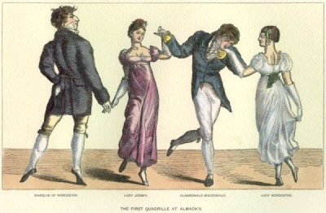
Images
The First Quadrille at Almack's

Slide 17
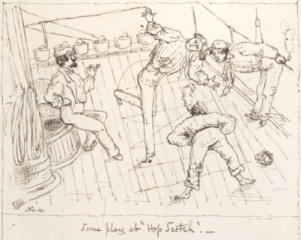
Some play at hop-scotch, by E. C. Moore. Image Courtesy of the National Library of Australia, PIC T1757 NK4270

Slide 18
Glossary of Terms
Chief Mate
First officer directly coming under the command of the captain. Ships’ Mates were responsible for supervising watches, crew, navigation and safety equipment, and sometimes even served as the ship’s doctor.
dead lights
A strong shutter or plate fastened over a ship’s porthole or cabin window in stormy weather.
Intermediate berths/cabins
Cabins of lesser comfort than those occupied by privileged passengers and intermediate between them and the dormitory accommodation afforded the emigrants.
Latitude
Latitude is the distance of a point north or south of the equator as measured in degrees. The poles are at 90 degrees north and south.
Longitude
Longitude is the distance, measured in degrees, of the meridian on which a point lies to the meridian of Greenwich. On the other side of the earth to Greenwich is a point with a longitude of both 180 degrees east and 180 degrees west.
Return to Journal Entries

Slide 19
poop
Technically called a stern deck, the poop is an exposed partial deck on the stern (rear) of a ship. It forms the roof of the stern or ‘poop’ cabin.
Quadrilles
A dance performed by four couples. It became popular in England after 1813.
Quarter Deck
The quarterdeck was the deck between the main mast and the back of the ship.
Reefs
Seafarers reduce sails in strong winds so that ships can move more safely and comfortably. Sails are made with rows of small ropes attached to them and these are tied around spars to reduce the amount of sail exposed to the wind. The amount of sail taken in by securing one set of ropes is called a reef. The action of reducing sails is called reefing and the knot that is used to tie the ropes is called a reef knot. In light winds all the reefs are taken out and the full size of the sail is exposed to draw full power from the wind.
Second mate
A merchant ship’s officer next in rank below the first mate; also known as a ‘second officer’.
Studding Sails
Studding sails were set outside the square sails in fine weather and with a fair wind. Their head was fastened to a short yard hoisted to the end of the upper yard and their foot extended by a boom slid out from the lower yard. They took their name, such as main topmast studding sail, from the adjacent sail.
Return to Journal Entries

