Slide 1
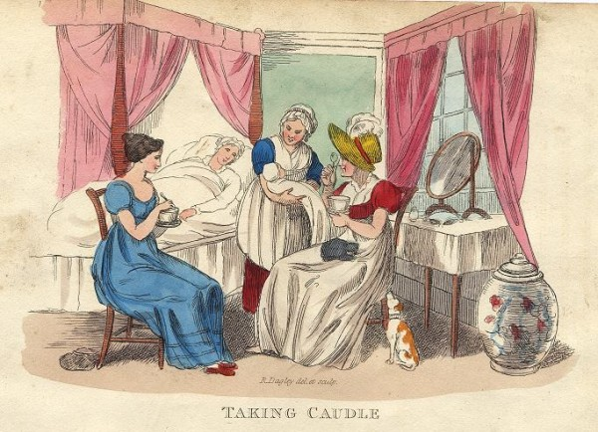
Bound for South Australia 1836 Family Life Week 36
Taking Caudle, (baby, midwifery), Richard Dagleycaricature, 1821

Slide 2
Overview
Between February and July 1836 nine ships left Britain bound for the newly created province of South Australia. On-board the ships were passengers who over many long months braved the perils of the ocean, including some of the most treacherous seas in the world to begin a new life on the other side of the world.
This resource uses the stories from these nine ships as recorded by the passengers and crew in their personal journals.

Slide 3
Contents
Introduction
Journal entries
Inquiry Questions
Relevant images
Glossary of terms

Slide 4
Introduction
This week we read the exciting news about the birth of a baby onboard the
Buffalo. A number of family groups made the journey to South Australia in
1836 with many ships carrying infants and children. Imagine how this long
journey would appear through the eyes of a child compared to that of an
adult. How did the journey and associated risks differ between children and
adults? The long journeys to South Australia were testing times for families
with children, while the arrival in South Australia brought other challenges.

Slide 5
Journals from settlers in South Australia: Sunday 29 October 1836
William Light, who arrived in South Australia on board the Rapid wrote:
29 October-Very sudden changes, hot and cold alternately, with showers. At five p.m. Captain Lipson and Mr Pullen arrived in the hatch-boat, from Nepean Bay. I wrote to Captain Rolls of the Cygnet to receive on board Captain Lipson and his family and proceed to Port Lincoln.

Slide 6
Journals from passengers at sea: Sunday 29 October 1836
Captain George Martin, who arrived in South Australia on board the John Pirie
wrote:
Hobart Town, Oct. 29th 1836.
My Dearest Mary,
I have at length an opportunity of writing you, by the ship, Elphenston, to inform you that we have all arrived safe at our port; the first part of the passage till nearly as far as the Cape, we had very fine weather, never once having ocasion to take a reef in, but the remainder just nothing but dreadful gale but we did not suffer any loss, she being a very fine sea boat, and I made Kangaroo Island to the hour, the other two ships the Duke of York & Lady Mary Pelham, having left England one ten & the other fourteen days before me, arrived but five & ten days before me, so I think I don well in so small a vessel, particularly as both those vessels where fastsailers having been both Packets, the two Commissioners Ships we beat

Slide 7
one fourteen days & the other six weeks, I was three weeks short of four months from Dartmouth, nothing particularly happen’d on the passage except one of our women passengers jumpt overboard in the heat of passion, the vessel was going at the rate of six knots at the time, I put the vessel about emidiately & stood towards her & succeeded in picking her up just as she was going down, she soon recover’d but blam’d me for saving her, she afterwards refused to take any food or nurishment till she became really ill and …………….. leaving a husband and four young children one not then ween’d, but it was a great blessing to them all, for she was a most horrid wretch, all the rest I landed safe & well satisfied, but not so with either of the other vessels for they appear’d to have had nothing but quarreling all the passage out, and on shore after they landed, & the crews of the vessels in a very insebordinate state, till my arrival, and I soon set them to wrights, after having set them in Irons and it was out of the Manningers power to rule them, ther being no Gov. nor any power to inforce obedience, I on the contrary have not had the least dificulty with any one on board, after I had restored them all to good order & disiplene, the first Mirical I don was to join together two couple in holy Matrimony, one was no less a person than Mr. Stephens, the Maninger, after which Iset about exploring the country, but found Kangaroo Island, a most

Slide 8
wretched & barren place not worth anything, & feeling uneasy at the appearance of future prospects, I took a whaleboat, mand and arm’d it well, & went over to the main, which is but twelve miles across, I proceeded up the gulf of St Vincents to the distance of from 100 miles or more, landing ocasionally and walk’d inland, & I must confess, that in all my travels I never saw so fine a country before & abundance of fresh water, and but few natives, not having fell in with more than eight in all that extent of country; on my return I found the vessel nearly ready for sea again and having made my arrangements, and occording to my advice we proceeded for Hobart Town for sawd timber & such articles as I saw them most in need off, we had a very good passage of six days and had scearsly got in the river before Hobart Town was viseted with a continuation of most terrific gales for three weeks, such as has not been before experienced in the memory of any one in the Island, thank god is was now my watch below, on my arrival I was most heartely wellcom’d by every person I met…
…
Robert & George is going to school to morrow to Mr. Giblins Father, a very good school at New Town where I have got them to take both, through favour, for fifty pounds a year, I have provided them well with everything,

Slide 9
& I am happy to say they are fine Boys & loved by everyone who knows them, I have great hopes in them, & I trust in God, that my dear girls will prove a comfort to us also – I hope & trust you are all well in health, and that you have been abble to mannage to rub through. I have wrote to Mr Angas who I have no doubt will render you every assistance in his power & advance you what money you may require to fit yourself & children out little respectable, and also procure you a passage out, either to Kangaroo Island or Van Diemens Land, but I think you had best if possible endeavour to get to Hobart Town first, & I will see you shall be provided for on your arrivel, but should you arrive at Kangaroo Island first, you will find yourself well received, I shall have a house built, and a garden for you before you arrive; endeavour to provide yourself & children as respectable clothing as your means will enable you, I am thank God in better health than ever I was & getting very lusty, & I have every prospect of dooing well, having an oppertunety of making a good deal trading backwards & forwards to the —. Mrs. Stephens is inclined to afford me every oppertunety of adding to my stock, therefore with the blessings of God I trust we shall yet see better days, & God send you safe to me again, The best month for you to leave England so as to insure fine weather will be in the months of June or July, Ihope your brother & all his family are all well and in prosperety, I have

Slide 10
wrot to them, & I hope & trust Mother & Eliza with her children are also well & that you are friendly with all for belive me my dear Mary that it is far more pleasing to make friends than enemys, I sepose Parnell is dead, & I trust he died a christian, & confeced his falshoods, should your Mother & sister come out to this part I will do all I can for them, give my love to them, also give my love to Mr. & Mrs. Barrow, Carters, Quillys, Ann & all inquiring friends – Mrs. Lord lives in the country and I am informed she looks as well as ever, Should you see Mr. Simpson the Father of my secont mate give my best respects to him & his family & tell him I have great pleasure in giving a good account of his son, he behaves himself mutch to my satisfaction, he has been very attentive to my two Boys, in teaching them to read and write; & I shall not fail in advancing so soon as I see a good oppertunity.
You must take cear to have a few comforts with you when you leave, independant of the ship, as you are an old Traveler you are well aquainted with what is necessary, be sure you take plenty eggs with you for the children, you see that I have not been afraid to face my enemys, but I assure you that I have not one is thes whole place, & to prove that mycredit is good, I have sold Bills … of £200 for articles purchased her for our settlement, and it will I trust convince those persons who gave your

Slide 11
Mother such favourable account of me, that I am not afraid to meet any one in this world that I have seen before, I hope Marian is a good girl and is kind & obedient to you, for she ought to be a patern to the rest, I have no fear of Georgiana , give my love to them all & kiss them all for their Father. I hope little Tom is growing a fine boy as will Isabella, Polly, & dear little Stewart. I hope you have not neglected poor Polly lip, Robert & George send their dear love to you & their sisters & brothers, Robert never hears your name mentioned but he crys bitterly, poor George he often talks of you but of course have not that sense of feeling, he is the fiddle of the vessel, once more give my love to all inquiring friend and accept the love of Your ever Afectionad Husband, George Martin.
Mr. & Mrs. Bascombe sends their best respects God bless you & send you soon to me.
Bring the certificate of your Marriage & the births of Marian & Thomas, for should anything happen to me you can get your Dower of that 800 acres of land which is now become very valuable.

Slide 12
Inquiry Questions
Why were family groups invited to establish the colony of South Australia?
How were the ships organised to cater for family groups, (e.g. cabins and sleeping)?
What were English family structures like in 1836?
How have family structures changed since 1836?

Slide 13
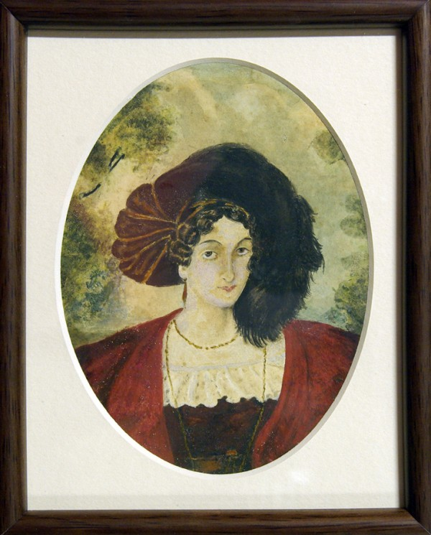
Images
Mary Thomas, painted by her daughter Frances, aged fourteen. 1834. Image courtesy of the Estate of Joan Kyffin Willington

Slide 14
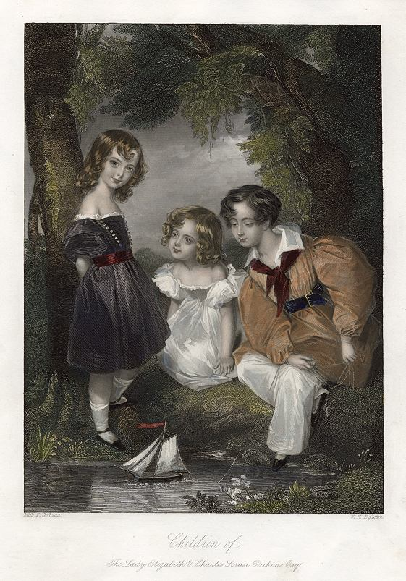
"Children of the Lady Elizabeth & Charles Scrase Dickins" (playing with a toy sailing boat) engraved by W.H.Egleton after a picture by Miss. F.Corbaux, published in Fisher's Drawing Room Scrap Book, 1849.. Ref G6842

Slide 15
Glossary of Terms
Second mate
A merchant ship’s officer next in rank below the first mate; also known as a ‘second officer’.
Return to Journal Entries

